Slide 1
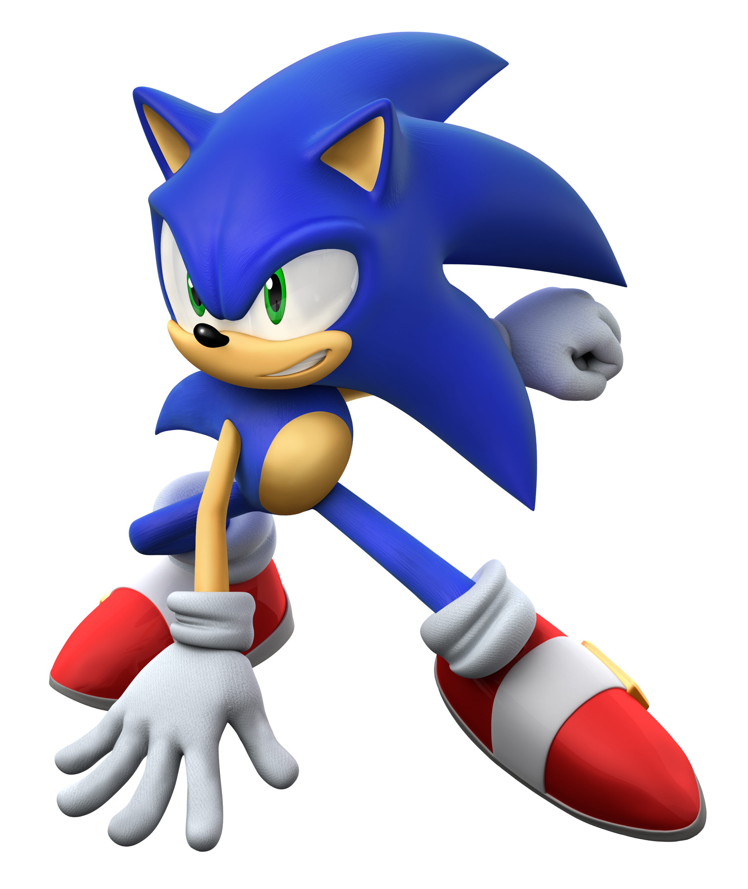

Super
Torin Rettig

Slide 2
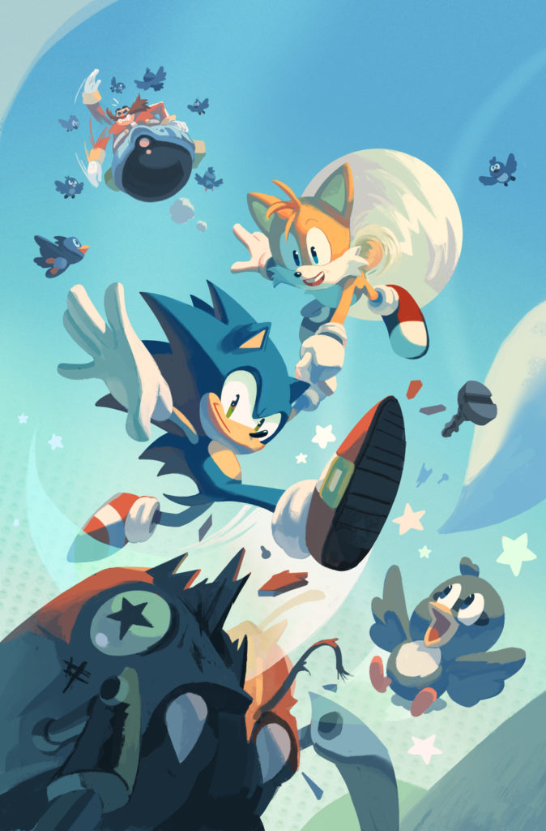
Project
Can we teach an AI agent to finish the first level of the classic game Sonic the Hedgehog?

Slide 3
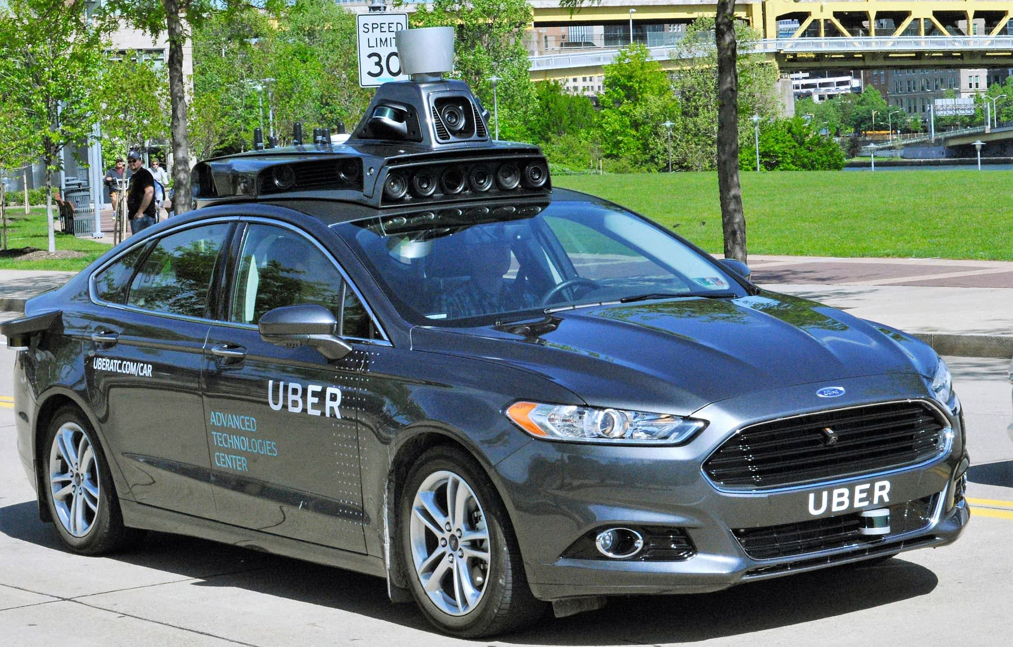

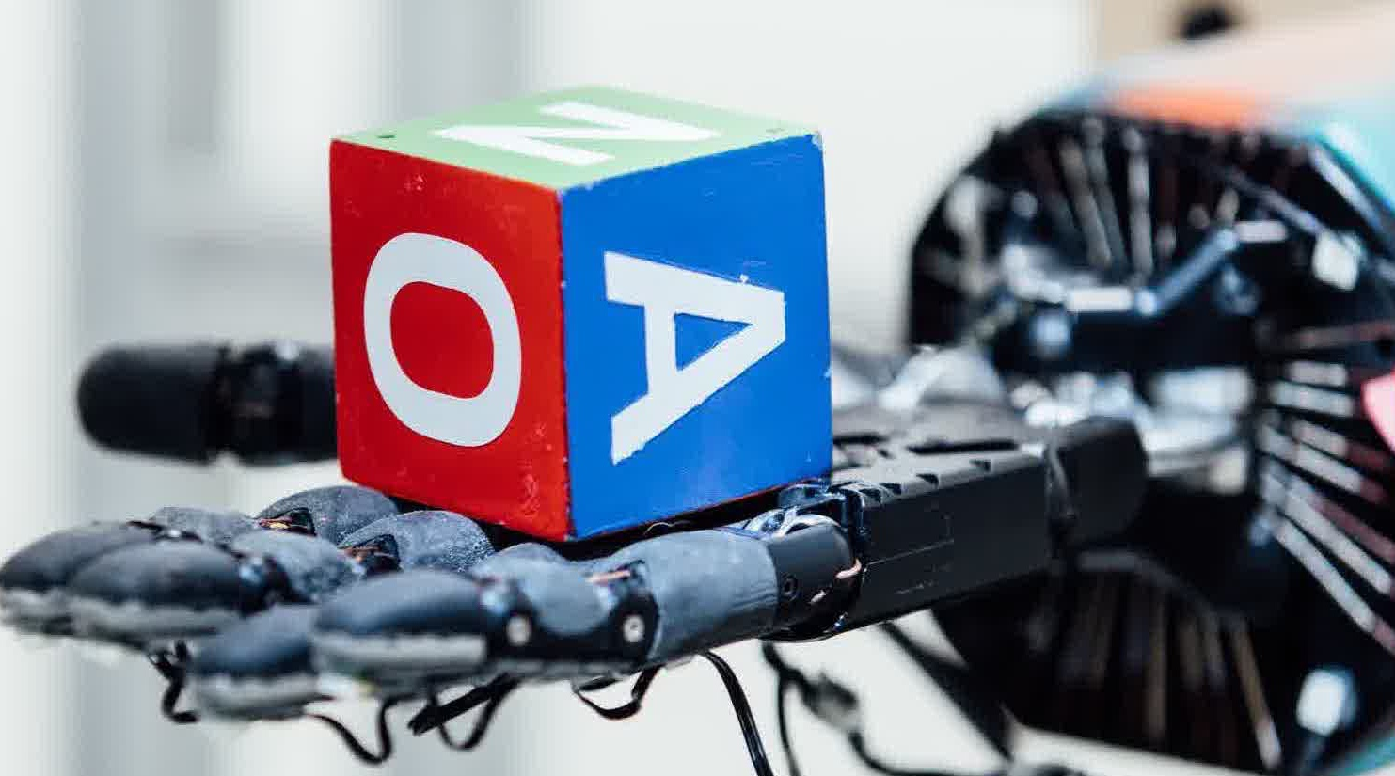
Reinforcement Learning
Training an AI agent to maximize some long-term goal (score, fastest time)
Apply in delayed reward domains like self-driving cars, supply chain, robotics
Take learnings from game simulation and apply to other fields
Notes:
Real-world business challenges
Reinforcement learning uses techniques similar to how people behave to optimize their long term goals

Slide 4
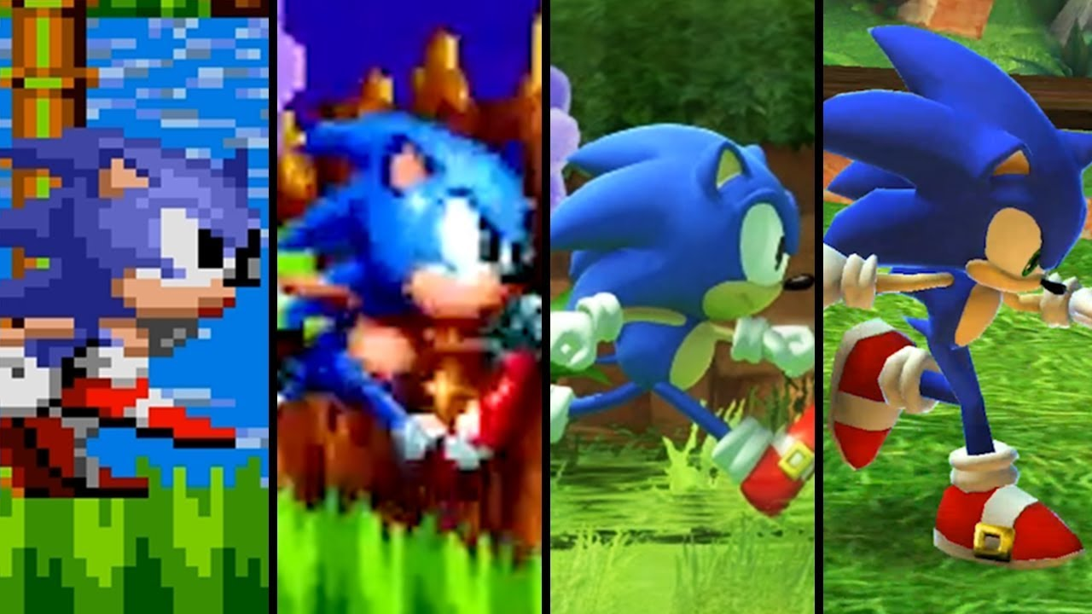
Sonic’s Goal = Move Right
For Sonic the reward is moving right to get to the end
Get as far right as possible as fast as possible
RL teaches Sonic to find the optimal strategy over time

Slide 5
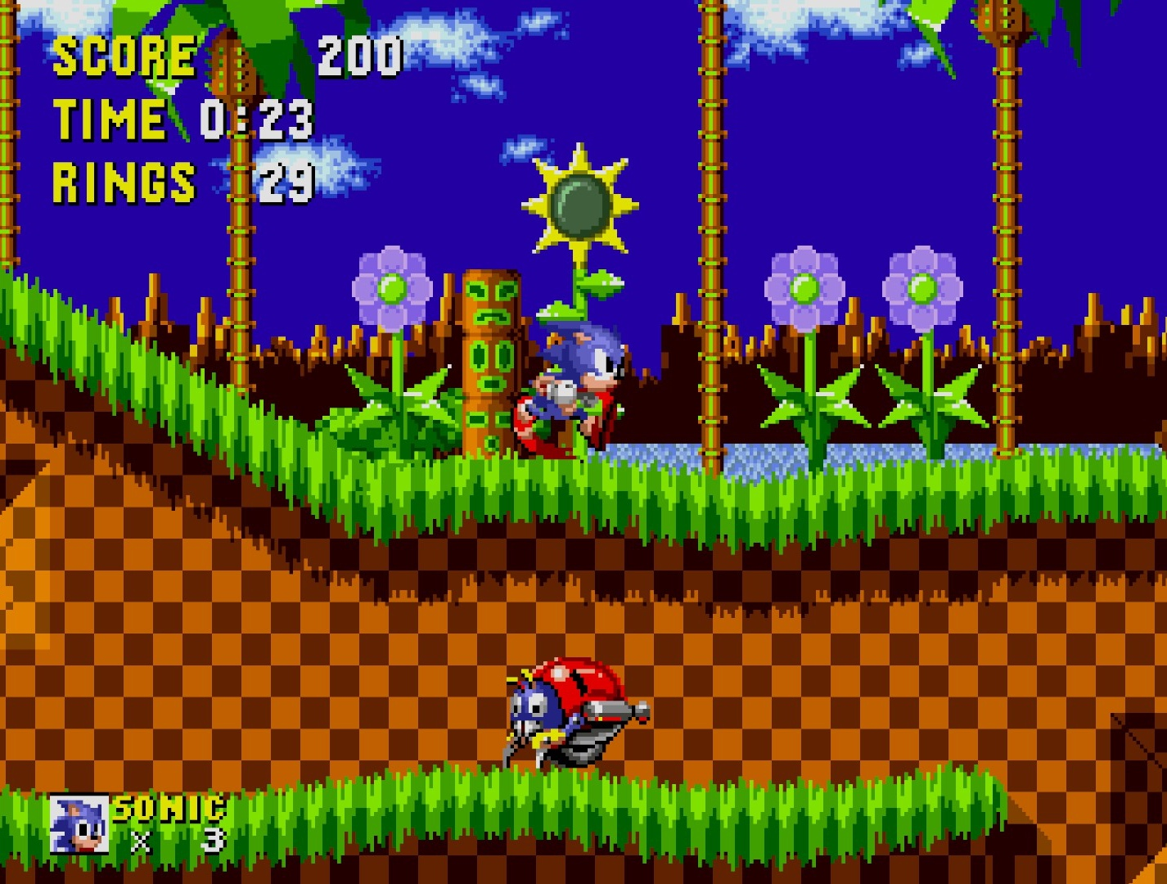
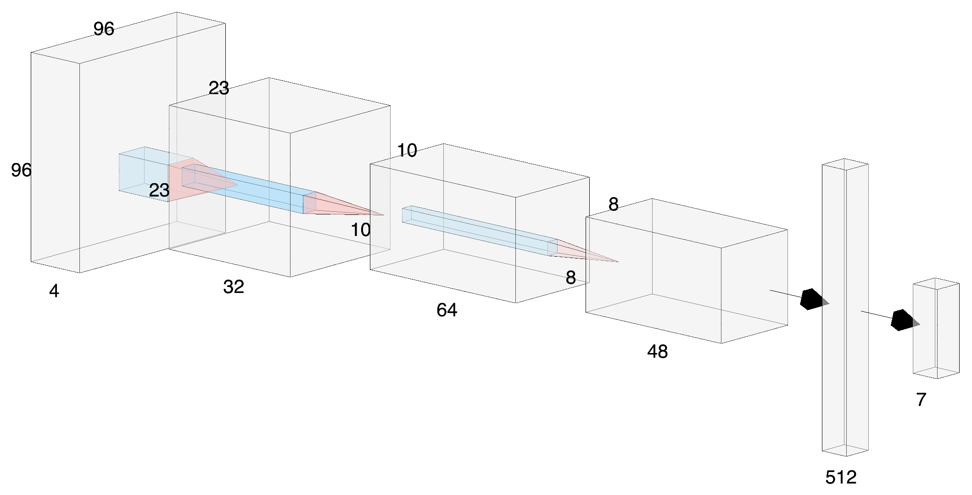


Final Model: Proximal Policy Optimization
JUMP!
Critic
Actor

Slide 6

Super Sonic Action!

Slide 7
Project
Can we teach an AI agent to finish the first level of the classic game Sonic the Hedgehog?
Yes!

Slide 8
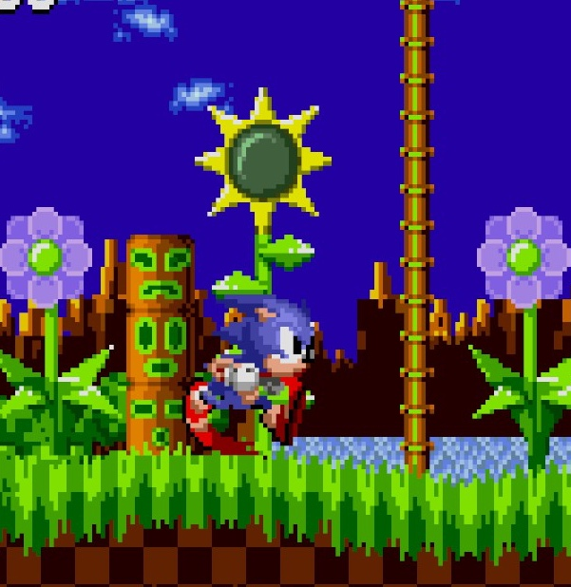
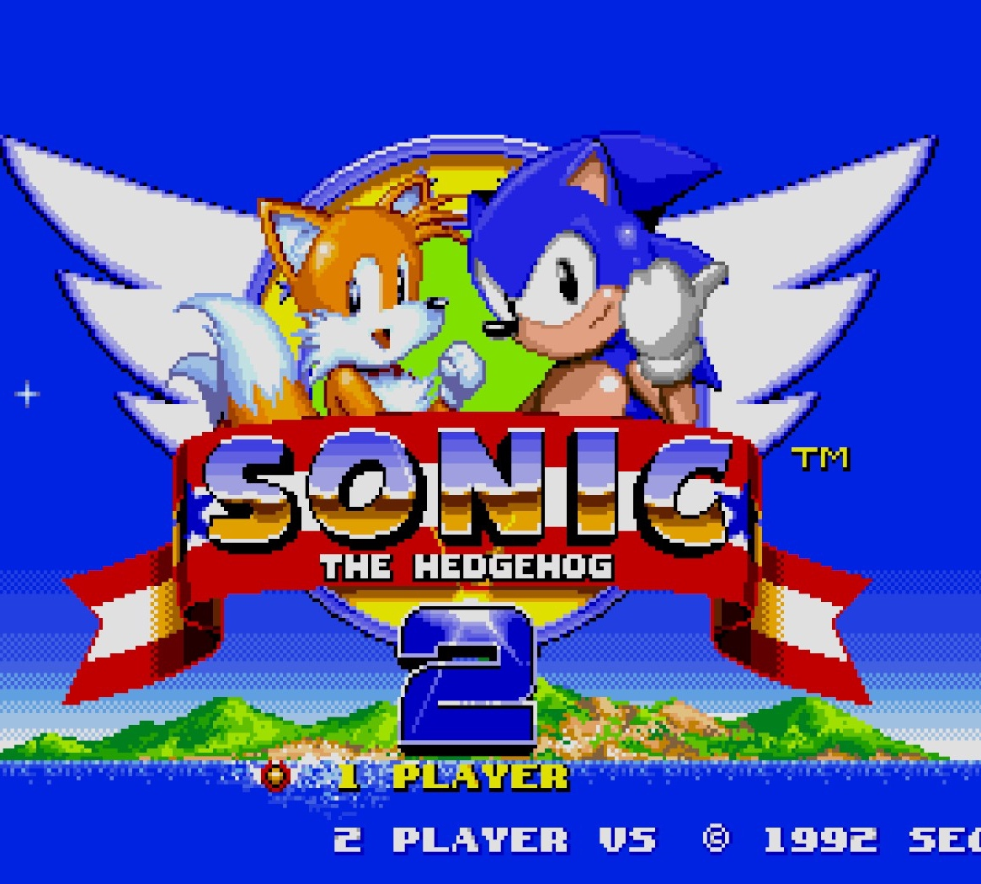
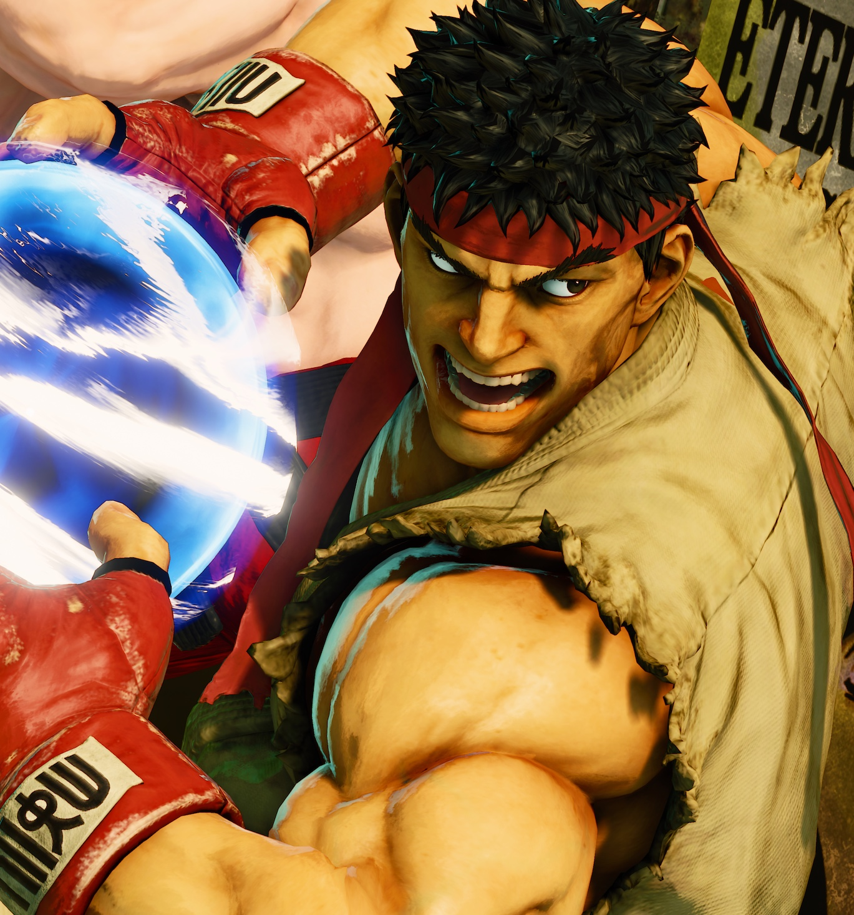
Future Work
Improve upon Sonic models and parameters
Transfer learning to different Sonic games
Street Fighter Combo Master

Slide 9
Thank You!

Slide 10







Contact
Tools
Torin Rettig
https://www.linkedin.com/in/torin-rettig/
OpenAI Gym
Python
References
Thomas Simonini’s Deep Reinforcement Learning Course
Alexandre Borghi’s PPO2 Algorithm
OpenAI Retro Gym Sonic Contest
Deep Reinforcement Learning: Hands On – Maxim Lapam
MANY Medium articles

